Slide 1
Last time
  Review induction proofs
  Loop invariants
Today
  Theoretical efficiency metrics
    Basic notations
  A direct analysis of selection sort and insertion sort
  Asymptotic Notation

Slide 2
Elementary Algorithmics
Given a problem
  What’s an instance
  Instance size
What does efficiency mean?
  Time
  Space

Slide 3
Instance of a problem
Instance: problem + input
Problem: calculate Fibonacci(n)
  Fibonacci(45) is an instance of the problem
Domain of definition of a problem: the set of instances to be considered
  A correct algorithm should work for every instance

Slide 4
Efficiency of an algorithm
Efficiency
  Time, space, energy
  Measured as a function of the size of the instances considered
Input Size
  The size of an instance/input
    corresponds formally the number of the bits needed to represent the instance on a computer
    A less formal definition: any integer that in some way measures the number of components in an instance
      For example, sorting, graphs
    For problems involving integers, we use value rather than size
Running time
  The number of primitive operations executed in terms of input size.

Slide 5
Approaches to measure efficiency
Empirical Approach
  Experiments through limited instances
Theoretical Approach (one focus of this course)
  Determines mathematically the quantity of resources needed by an algorithm
Hybrid approach
  Given an implementation in a machine, predict the efficiency of an instance using limited experiments

Slide 6
Average, best, and worst case analysis
How to compare two algorithms
  Worst case, average, best case
Worst case
  Appropriate for an algorithm whose response time is critical
Average
  For an algorithm which is to be used many times on many different instances
  Harder to analyze, need to know the distribution of the instances
Best case

Slide 7
Machine Model and Elementary (Primitive) Operation
Assuming RAM (random-access machine) model
  Instructions and costs are well-defined
  Realistic
  No concurrent operations
An elementary (primitive) operation is one whose execution time can be bounded above by a constant depending only on the particular implementation—the machine, the programming language, etc.
Example
  X = Sum{A[i] | 1 <= i <= n}
  Fibonacci sequence, addition may not be an elementary operation

Slide 8
Insertion sort vs. Selection sort
void insertionSort(int A[], int n)
{
int i, j, tmp;
for (i=1; i<n; i++) {
tmp=A[i];
j = i-1;
while (j>=0 && tmp<A[j]) {
A[j+1] = A[j];
j--;
}
A[j+1] = tmp;
}
}
int selectionSort(int A[], int n)
{
int i, j, minj, minv;
for (i=0; i<n-1; i++) {
minj=i; minv=A[i];
for (j=i+1; j<n; j++) {
if (A[j]<minv) {
minv = A[j];
minj = j;
}
}
A[minj] = A[i];
A[i] = minv;
}
}
For best-case and worst-case, consider:
A is in ascending order
A is in descending order

Slide 9
A detailed worst–case analysis of selection sort
int selectionSort(int A[], int n)
{
int i, j, minj, minv;
for (i=0; i<n-1; i++) {
minj=i; minv=A[i];
for (j=i+1; j<n; j++) {
if (A[j]<minv) {
minv = A[j];
minj = j;
}
}
A[minj] = A[i];
A[i] = minv;
}
}
Assumption!
First time 3, later 2
1 + 2
First time 3, later 2
2
2
1
3
2
n-1 times
n-i-1 times
Total elementary operations:

Slide 10


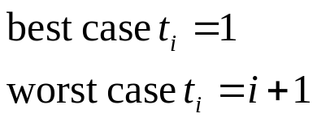
Insertion sort analysis
void insertionSort(int A[], int n)
{
int i, j, tmp;
cost times
for (i=1; i<n; i++) { c₁ n
tmp=A[i]; c₂ n-1
j = i-1; c₄ n-1
while (j>=0 && tmp<A[j]) { c₅
A[j+1] = A[j]; c₆
j--; c₇
}
A[j+1] = tmp; c₈ n-1
}
}

Slide 11

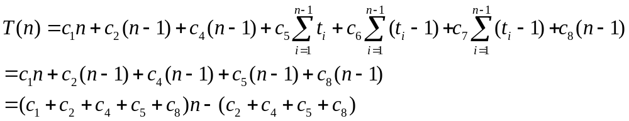
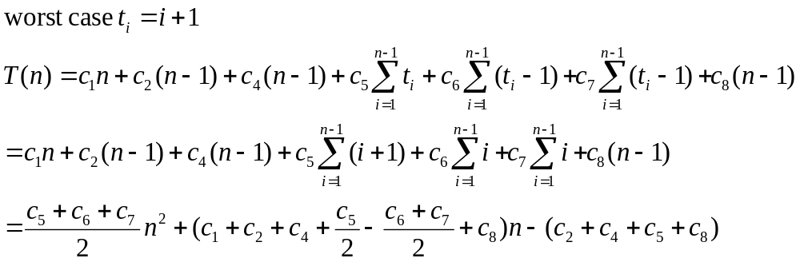
Insert sort cost

Slide 12
Asymptotic Notation
What does “the order of” mean
Big O, Ω, and Θ notations
Properties of asymptotic notation
Limit rule

Slide 13
A notation for “the order of”
We’d like to measure the efficiency of an algorithm
  Determine mathematically the resources needed
There is no such a computer which we can refer to as a standard to measure computing time
We introduce “asymptotic” notation
  An asymptotically superior algorithm is often preferable even on instances of moderate size (We saw this when comparing two Fibonacci algorithms)

Slide 14
Efficiency of selection sort
T(n) is the time taken by selection sort
  We like to know the dominant factor in T(n)
T(n) = 7/2*n²+15n/2-10 <= 11*n²
We claim that T(n) is in the order of n² or O(n²)

Slide 15
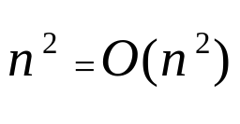
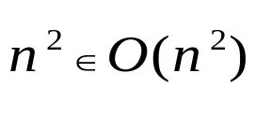
Definition of big O
Typically used for asymptotic upper bound
Attention
  O(f(n)) is a set of functions
Pitfall
  Traditionally we say as used in our text book
  It really means

Slide 16
A graphical view of asymptotic definition
cg(n)
f(n)
0
n₀
n

Slide 17




Example
Prove that following statements

Slide 18

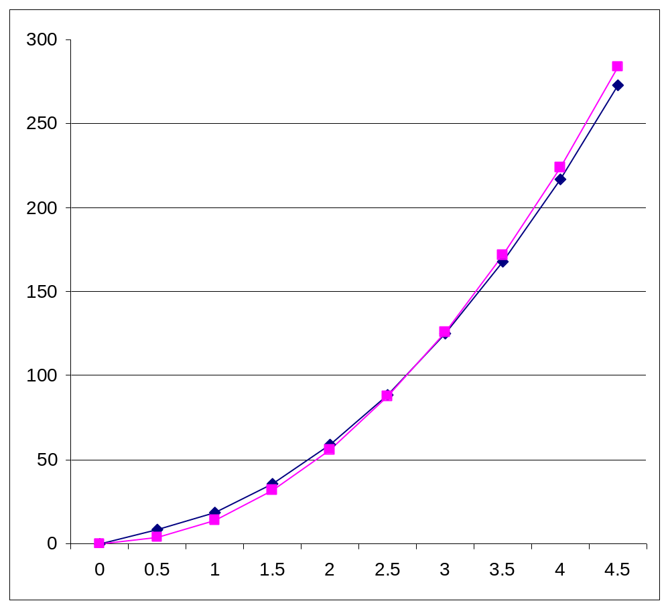


What are c and n₀?

Slide 19
Several notations
Logarithm time O(log n)
Linear time O(n)
Quadratic time O(n²)
Cubic time O(n³)
Exponential time O(c^{n}), c>1
Order of growth

Slide 20
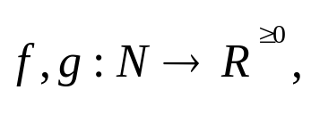
The Maximum rule
Let
then
Proof
  the key is max(f(n),g(n)) <= f(n)+g(n) <= 2*max(f(n),g(n))
Examples
  O(12n³-5n+nlogn+36)
The maximum rule let us ignore lower-order terms

Slide 21
Example
True or false
  ? 5  O(log n)
  ? log n  O(5)
  ? O(n)  O(n^{0.6}logn)
  ? O(n^{0.6}logn)  O(n)
  ? O(n⁸) = O((n²-3n+5)⁴)

Slide 22
Definition of Ω
Ω is typically used to describe asymptotic lower bound
  For example, insertion sort take time in Ω(n)
Ω for algorithm complexity
  We use it to give the lower bounds on the intrinsic difficulty of solving problems
  Example, any comparison-based sorting algorithm takes time Ω(nlogn)

Slide 23

The Θ notation
Used to describe asymptotically tight bound
Example: selection sort take time in Θ(n²)
Definition:
Equivalent to:

Slide 24
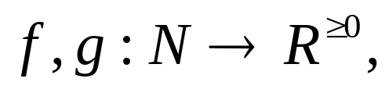
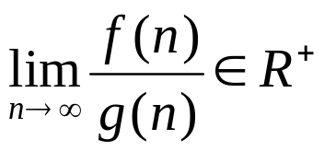

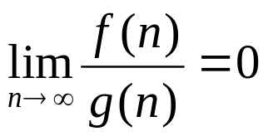


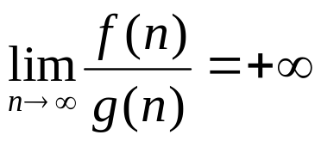


The Limit Rule
Let then
If then
If then but
If then but

Slide 25
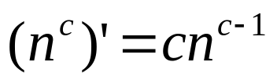
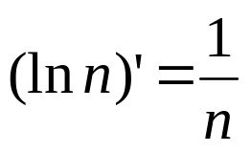
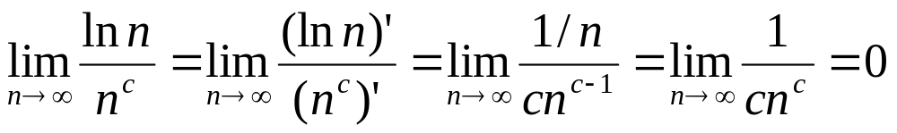
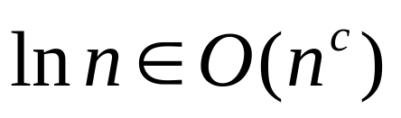
Example
(ln n means log_{e}n, the text use log)
When c>0
for any c>0

Slide 26
Semantics of big-O and Ω
When we say an algorithm takes worst-case time
t(n)  O(f(n)), then there exist a real constant c such that c*f(n) is an upper bound for any instances of size of sufficiently large n
When we say an algorithm takes worst-case time
t(n)  Ω(f(n)), then there exist a real constant d such that there exists at least one instance of size n whose execution time >= d*f(n), for any sufficiently large n
Example
  Is it possible an algorithm takes worst-case time O(n) and Ω(nlog n)?

Slide 27
Practice Problems
True or false
  The algorithm takes time in O(n²)
  The algorithm takes time in Ω(n²)
  The algorithm takes time in O(n³)
  The algorithm takes time in Ω(n³)
  The algorithm takes time in Θ(n³)
  The algorithm takes time in Θ(n²)
  The algorithm takes worst case time in O(n³)
  The algorithm takes worst case time in Ω(n³)
  The algorithm takes worst case time in Θ(n³)
  The algorithm takes best case time in Ω(n³)
anAlgorithm( int n)
{
// if (x) is an elementary
// operation
if (x) {
some work done
by n² elementary
operations;
} else {
some work done
by n³ elementary
operations;
}
}

Slide 28
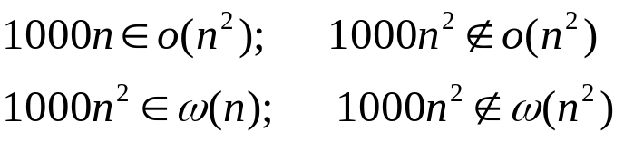
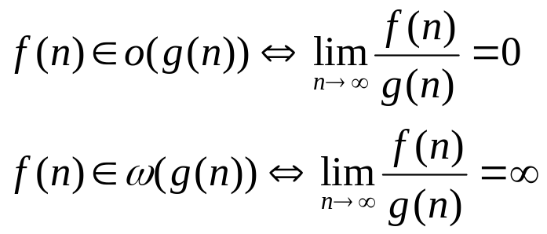
Definition of o and ω
Definition
Denote upper/lower bounds that are not asymptotically tight
Example
Properties

Slide 29
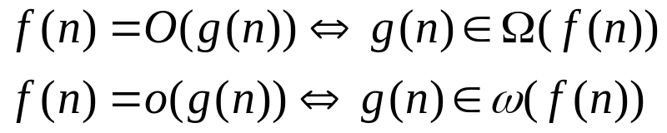
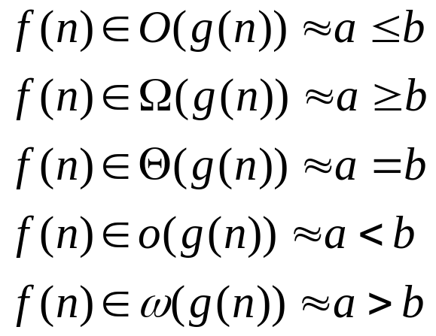
Relational Properties
Transtivity: O, o, Ω, ω,Ө
Reflexity: O, Ω, Ө
Symmetry:
Transpose symmetry (Duality)
Analogy

